Slide 1

Lake County Safety Council
Thursday, December 9 Meeting
Back to the Basics – Part II:
Emergency Action Plans, Confined Spaces, Powered Industrial Trucks, Hazard Communications and 40 CFR 260-279 Resource Conservation Recovery Act

Slide 2

Event Sponsor
HZW Environmental Consultants

Slide 3


Event Sponsor
Lake Health
Occupational Services

Slide 4
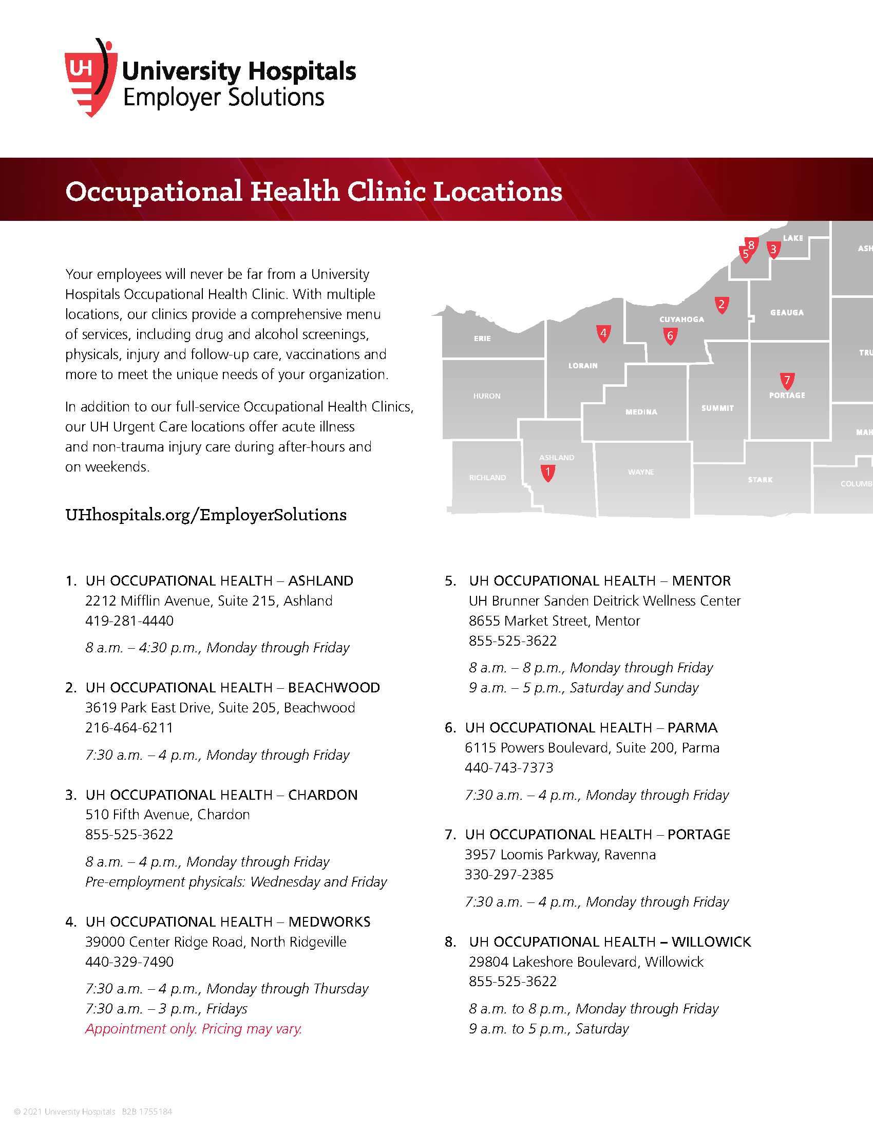
Event Sponsor
University Hospitals Employer Solutions
Occupational Services

Slide 5


Slide 6

It’s a whole new world
Covid-19 induced turnover
Downsizing workforce
Doubling workforce
New responsibilities for current employees
Limited resources
  Lead time shrinkage
  Supply chain delays
  Cash
Notes:
The majority of businesses in the United States are currently behaving like a new start up business.
Trying to solve staffing problems
Unreliable supply chain causing us all to locate new vendors and spend the nights trying to come up with creative ways to solve production issues.
A year and a half ago we went from 70 miles per hour to 0 within days. Now we are going from 0 to 100 in hours.
Replacement staff has no experience.
Replacement supervisors have little understanding of safety and/or production.
Production needs work NOW! But we are not prepared with basic safety orientation.

Slide 7

Today I’m going to talk about Safety Basics
Emergency Action Planning
Confined Space Entry
Powered Industrial Trucks (Forklift)
Hazard Communication
Resource Conservation Recovery Act (RCRA)
Notes:
We don’t have time to get deep in the weeds on any of these topics. But we need to reset our foundation, layout a plan and start getting things under control given the current personnel challenges, business needs and resources constraints.

Slide 8
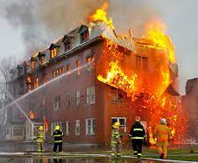
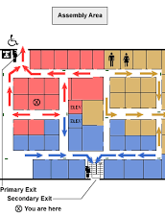
Emergency Action Plan

Slide 9
Realistically, what emergencies could we have?
Fire
Injury
Active Shooter
Chemical Spill or Release
Weather

Slide 10

Tabletop Planning
Gather a group and talk through all the logistics of each specific emergency.
Outcomes:
  Resources we need
  Training we need
  Policies that need developed
  Communication
  Prevention ideas

Slide 11

Training on the emergency action plan
Specific skills for response teams:
  Fire brigade
  First aid, CPR, and AED
  Chemical response
Overall understanding for everyone.
Walk through the response and take head counts.

Slide 12

Confined Spaces
Assessment
Identification
Entry procedures
Rescue
Training

Slide 13
Confined Space Assessment
Walk through the entire facility and look at everything
If it could be a confined space complete a written assessment
There are areas for interpretation
Large enough to enter
Access

Slide 14

Based on the assessment
Place labels at the access points.
Develop entry procedures:
  Lockout/Tagout
  Material Removal
  Voltage Testing
  Ventilation

Slide 15


Confined Space Training
Entry Team
Rescue Systems
First Aid, CPR, AED
Use of Ventilation
Air Monitoring and Calibration
Respiratory Protection

Slide 16
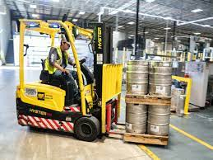
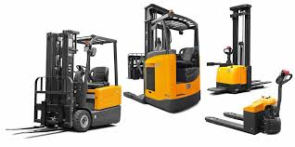
Powered Industrial Trucks

Slide 17
Training
General training in the classroom
Complete a written test
Lift-specific training
3-year update
Retraining for incidents or observations

Slide 18
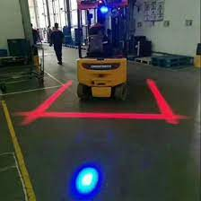

Other lift technology
Operator login codes
Remotely enable or disable the lift
Damage or collision detection
LED lights

Slide 19
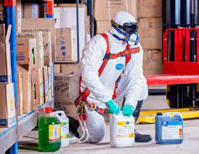
Hazard communication
OSHA Top 10 citations
Most employees have exposures

Slide 20
HAZCOM BASICS
Training to be functional
How do I handle it?
How do I store it?
What are the hazards and symptoms of exposure?
What do I need to wear working with it?
Find information
Training to be aware
Recognize chemicals
Understand how to avoid contact

Slide 21
Safety Data sheets
Who is going to gather and maintain SDSs?
Where will they be located so employees can access them?
When do they get updated?
How will they be filed?

Slide 22

Annual audit
Conducted by the program administrator
Interview employees
Chemical inventory
Observations of behaviors
Check temporary labeling

Slide 23

Intro to Resource Conservation and Recovery Act (RCRA)
Promote and protect human health and the environment, conserve energy and resources.
Reduce or eliminate the generation of hazardous wastes as expeditiously as possible.
When hazardous waste is generated, hold the generator responsible through “cradle-to-grave” system.
Notes:
(Write the acronym “RCRA” on the board so students can correlate the acronym with the name of the act.)
“RCRA was enacted by Congress in 1976 to regulate the management of solid and hazardous wastes. The general goals that were outline by congress in RCRA were:
1. To protect human health and the environment
2. To reduce waste and conserve energy and natural resources
3. To reduce or eliminate the generation of hazardous waste as expeditiously as possible.”
RCRA requires generators of hazardous waste, like the organizations you represent, to properly manage hazardous wastes from cradle to grave: from the point of generation to the point that the waste is either no longer hazardous or it is destroyed. In the case of wastes that cannot be rendered non-hazardous or destroyed, the generator remains liable for the waste forever, even after it is placed in a landfill.”

Slide 24
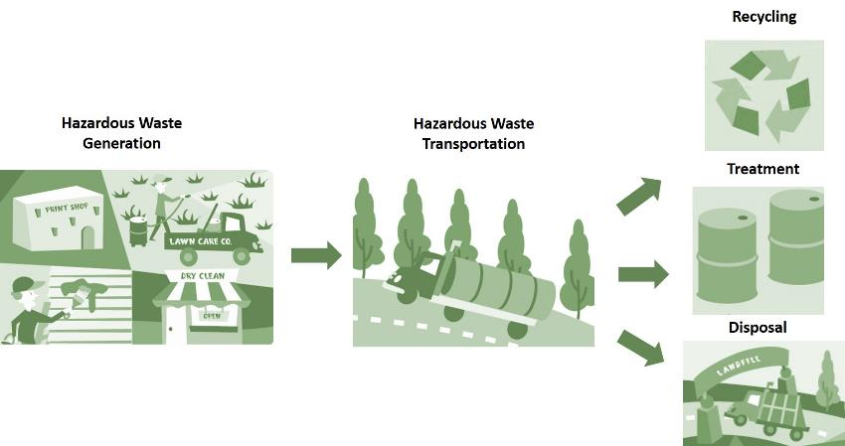
“Cradle to Grave”
Notes:
Idea behind cradle to grave is that the generator is responsible for seeing the hazardous substance through to its end, where it is treated, recycled or disposed of. The generator is responsible for the hazardous waste until its no longer hazardous.

Slide 25
Ten Principles of
Hazardous Waste Management
Report to Ohio EPA
Tank and Container Management
Characterize your wastes
How much waste is generated?
Storage Time and Quantity Limits
Notes:
“To help guide you in the proper management of hazardous wastes, we have organized the regulatory requirements for hazardous waste management into the following ten principles. In theory, if you understand and follow these principles, you should be in compliance with Ohio hazardous waste regulations.”
(Read the principles with little elaboration since you’ll be discussing them in detail in subsequent slides.)
1. Characterize your wastes
2. Determine how much hazardous waste you generate
3. Report to OEPA
4. Observe storage time and quantity limits
5. Properly manage containers/tanks of hazardous waste

Slide 26
Ten Principles of
Hazardous Waste Management (CONT’D)
Plan for Emergencies
Employee
Training
Pollution Prevention
Waste Disposal and Shipping
Recordkeeping
Notes:
Plan for emergencies
Properly ship and dispose of wastes
Train your employees
Keep appropriate records
Practice pollution prevention

